Slide 1


Administer Network Traffic

Slide 2



Configure Network Routing and Endpoints

Slide 3

Review System Routes
System routes direct network traffic between virtual machines, on-premises networks, and the internet:
Traffic between VMs in the same subnet
Traffic between VMs in different subnets in the same virtual network
Data flow from VMs to the internet
Communication between VMs using a VNet-to-VNet VPN
Site-to-Site and ExpressRoute communication through the VPN gateway
Internet
System Route
Frontend Subnet
Backend Subnet
Routing Table
Virtual Network

Slide 4
Identify User-Defined Routes
A route table contains a set of rules, called routes, that specifies how packets should be routed in a virtual network
Internet
User defined Route
VM/Appliance IP Forwarding
User-defined routes are custom routes that control network traffic by defining routes that specify the next hop of the traffic flow
System Route
Frontend Subnet
Backend Subnet
User defined Route
The next hop can be a virtual network gateway, virtual network, internet, or virtual appliance
VM/Appliance IP Forwarding
Virtual Network

Slide 5


Demonstration – Custom Routing Tables
Create a route table
Add a route
Associate a route table to a subnet
Use PowerShell to view your routing information (optional)

Slide 6
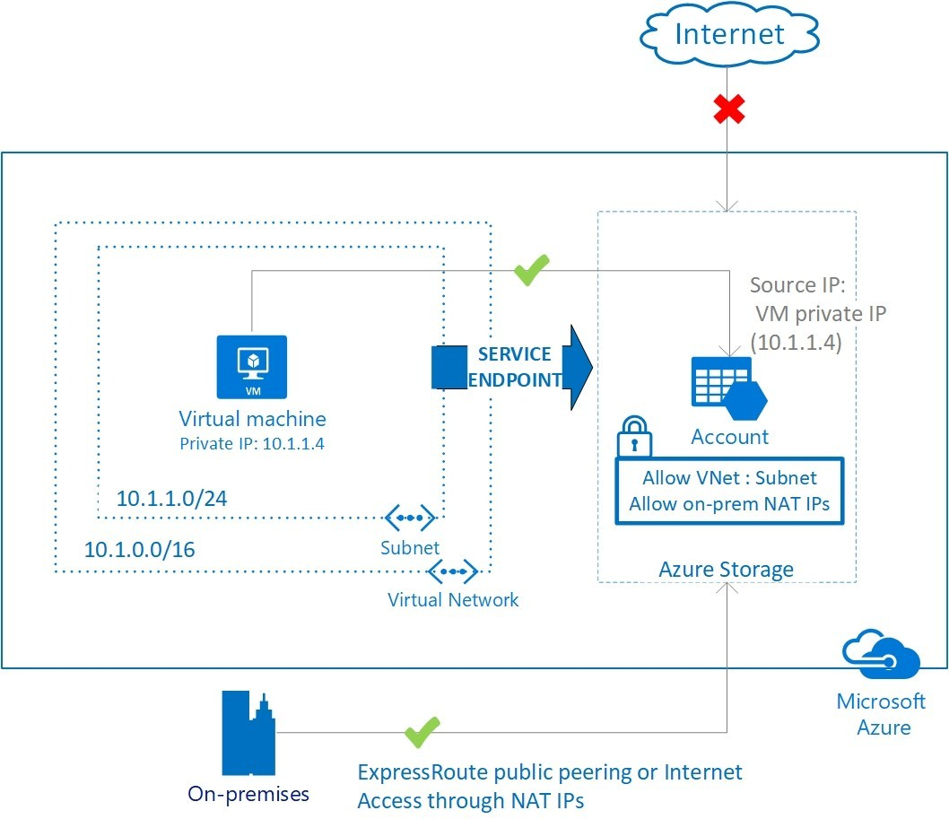
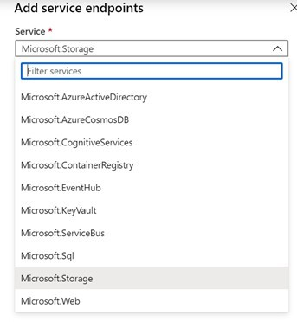
Determine Service Endpoint Uses
Endpoints limit network access to specific services -Adding service endpoints can take up to 15 minutes to complete

Slide 7
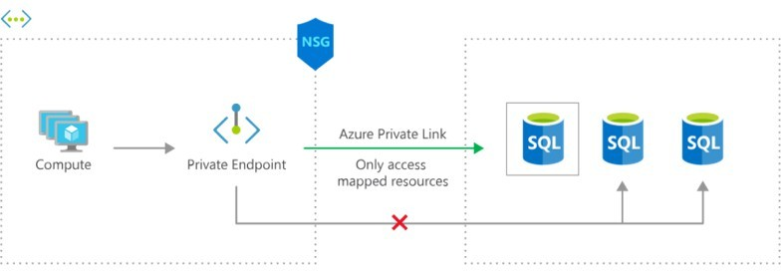
Identify Private Link Uses
Private connectivity to services on Azure. Traffic remains on the Microsoft network, with no public internet access
Integration with on-premises and peered networks
In the event of a security incident within your network, only the mapped resource would be accessible

Slide 8
Configure Azure Load Balancer

Slide 9
Choose a Load Balancer Solution
Feature | Application Gateway | Front Door | Load Balancer | Traffic Manager
Usage | Optimize delivery from application server farms while increasing application security with web application firewall. | Scalable, security- enhanced delivery point for global, micro service-based web applications. | Balance inbound and outbound connections and requests to your applications or server endpoints. | Distribute traffic optimally to services across global Azure regions, while providing high availability and responsiveness.
Protocols | HTTP, HTTPS, HTTP2 | HTTP, HTTPS, HTTP2 | TCP, UDP | Any
Private | Yes |  | Yes
Global |  | Yes |  | Yes
Env | Azure, non-Azure cloud, on premises | Azure, non-Azure cloud, on premises | Azure | Azure, non-Azure cloud, on premises
Security | WAF | WAF, NSG | NSG

Slide 10
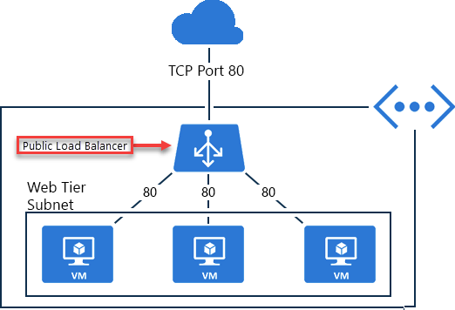
Implement a Public Load Balancer
Maps public IP addresses and port number of incoming traffic to the VM’s private IP address and port number, and vice versa
Apply load balancing rules to distribute traffic across VMs or services

Slide 11
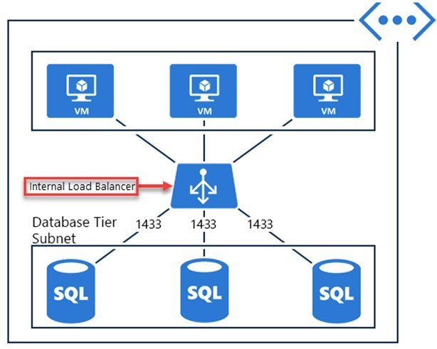
Implement an Internal Load Balancer
Directs traffic only to resources inside a virtual network or one that uses a VPN to access Azure infrastructure
Frontend IP addresses and virtual networks are never directly exposed to an internet endpoint
Enables load balancing within a virtual network, for cross-premises virtual networks, for multi-tier applications, and for line-of-business applications

Slide 12
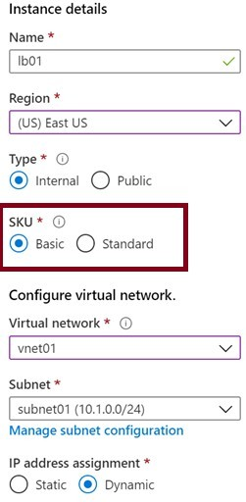
Determine Load Balancer SKUs
Feature | Basic SKU | Standard SKU
Backend pool | Up to 300 instances | Up to 1000 instances
Health probes | TCP, HTTP | TCP, HTTP, HTTPS
Availability zones | Not available | Zone-redundant and zonal frontends for inbound and outbound traffic
Multiple frontends | Inbound only | Inbound and outbound
Secure by default | Open by default. NSG optional. | Closed to inbound flows unless allowed by a NSG. Internal traffic from the virtual network to the internal load balancer is allowed.
SLA | Not available | 99.99%

Slide 13
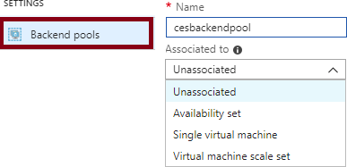
Create Backend Pools
SKU | Backend pool endpoints
Basic SKU | VMs in a single availability set or VM scale set
Standard SKU | Any VM in a single virtual network, including a blend of VMs, availability sets, and VM scale sets
To distribute traffic, a back-end address pool contains the
IP addresses of the virtual NICs that are connected to the load balancer

Slide 14
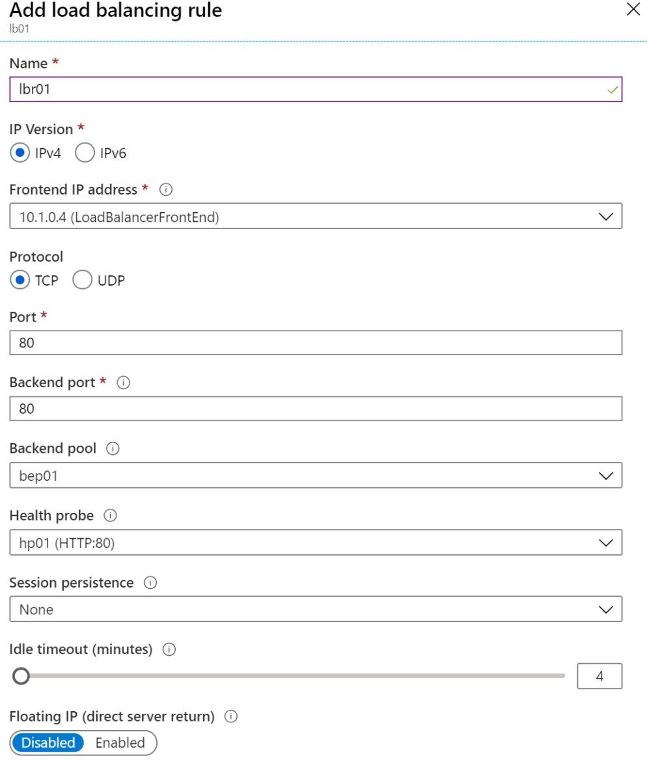
Create Load Balancer Rules
Maps a frontend IP and port combination to a set of backend pool and port combination
Load Balancer Rules can be combined with NAT rules
A NAT rule is explicitly attached to a VM (or network interface) to complete the path to the target

Slide 15
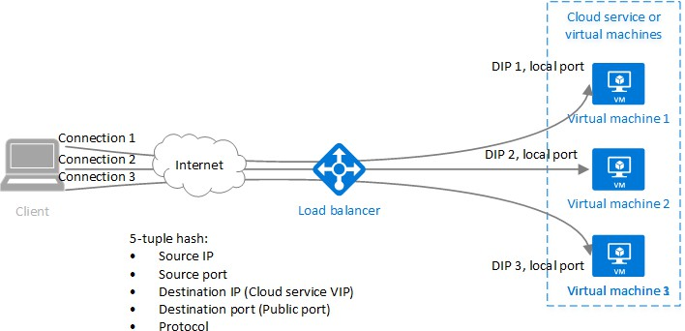
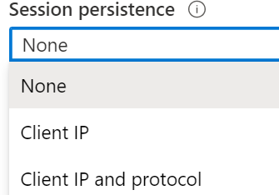
Configure Session Persistence (optional)
Session persistence specifies how client traffic is handled
None (default) requests can be handled by any virtual machine
Client IP requests will be handled by the same virtual machine
Client IP and protocol specifies that successive requests from the same address and protocol will be handled by the same virtual machine

Slide 16
Configure Azure Application Gateway

Slide 17
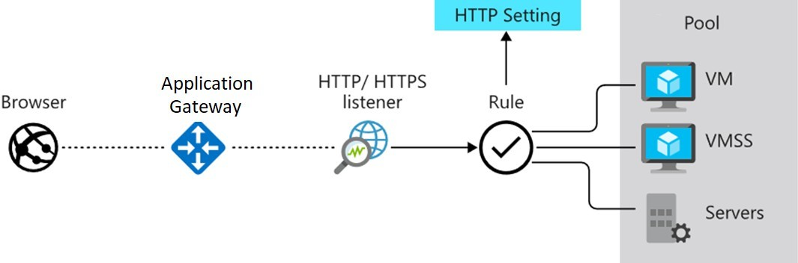
Implement Application Gateway
Manages web app requests
Routes traffic to a pool of web servers based on the URL of a request
The web servers can be Azure virtual machines, Azure virtual machine scale sets, Azure App Service, and even
on-premises servers

Slide 18
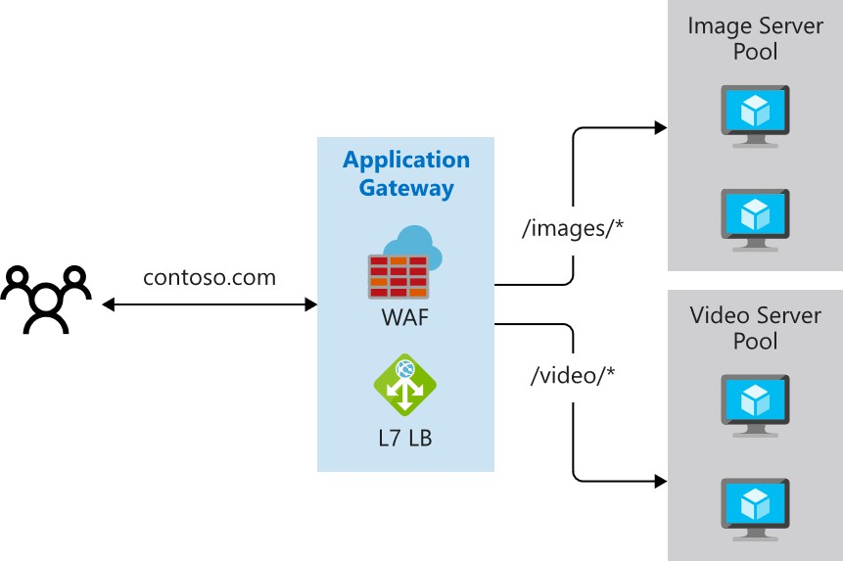
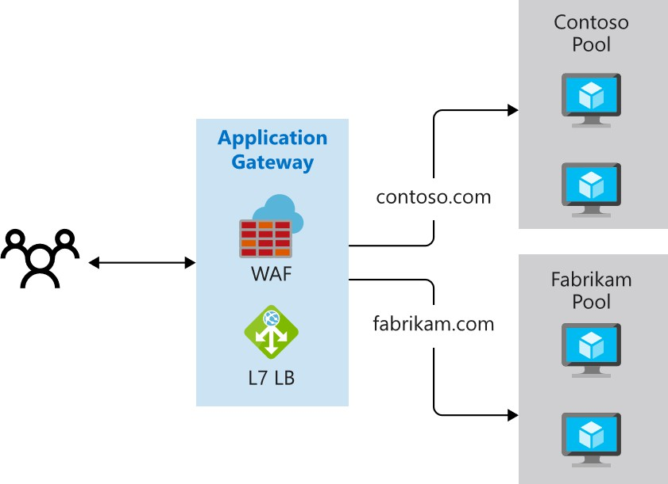
Determine Application Gateway Routing
Path-based routing
Multiple-site routing

Slide 19
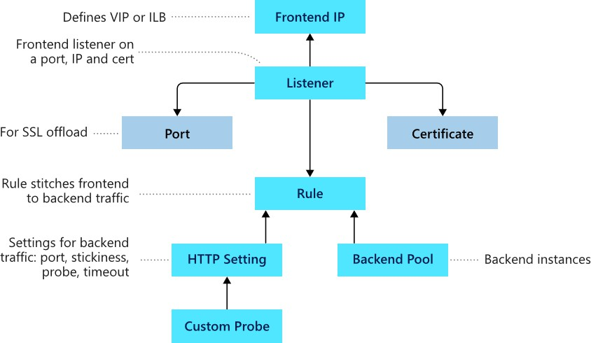
Setup Application Gateway Components (optional)
Frontend IP
Listeners Routing rules Backend pools Web application
firewall (optional)
Health probes

Slide 20
Configure Network Watcher

Slide 21
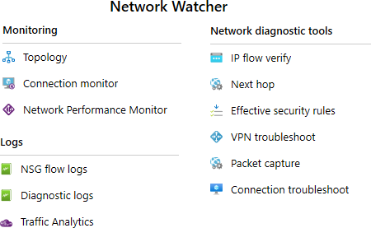
Describe Network Watcher Features
A regional service that provides various network diagnostic and monitoring tools
IP Flow Verify diagnoses connectivity issues
Next Hop determines if traffic is being correctly routed
VPN Diagnostics troubleshoots gateways and connections
NSG Flow Logs maps IP traffic through a network security group
Connection troubleshoot shows connectivity between source VM and destination
Topology generates a visual diagram of resources

Slide 22
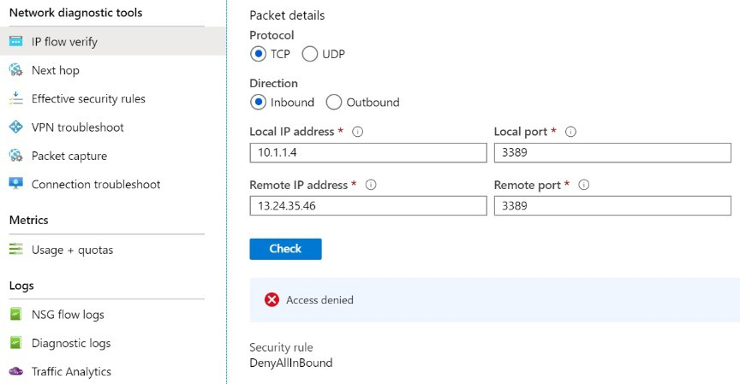
Review IP Flow Verify Diagnostics
Checks if a packet is allowed or denied to or from a virtual machine

Slide 23
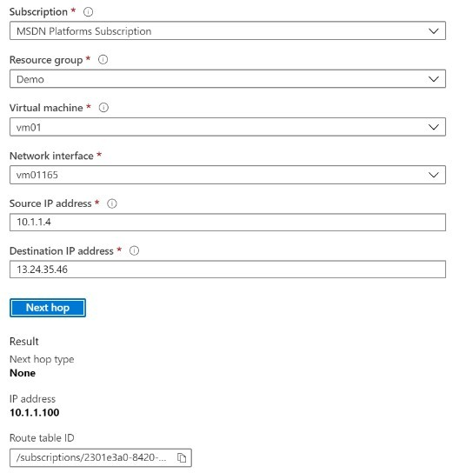
Review Next Hop Diagnostics
Helps with determining whether traffic is being directed to the intended destination by showing the next hop

Slide 24
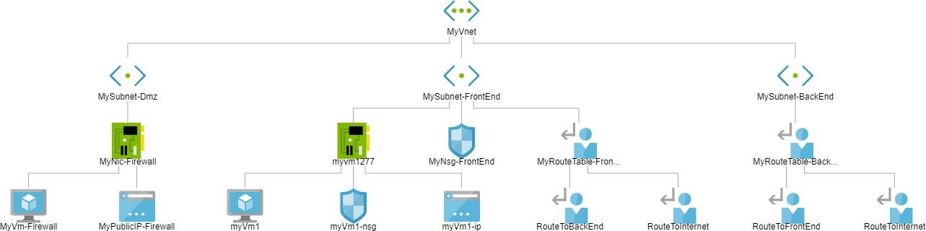
Visualize the Network Topology
Provides a visual representation of your networking elements
View all the resources in a virtual network, resource to resource associations, and relationships between the resources
The Network Watcher instance in the same region as the virtual network

Slide 25
Lab – Implement Traffic Management

Slide 26
Lab 06 – Implement traffic management
Scenario
You are tasked with implementing a hub spoke topology for network traffic. The topology should include an Azure Load Balancer and Azure Application Gateway.
Objectives
Task 1: Provision the lab environment
Task 2:
Configure the hub and spoke network topology
Task 3:
Test transitivity of virtual network peering
Task 4:
Configure routing in the hub and spoke topology
Task 5: Implement Azure Load Balancer
Task 6:
Implement Azure Application Gateway

Slide 27








Lab 06 – Architecture Diagram
Task6
az104-06-rg5
Task1
az104-06-rg1
az104-06-vnet01 10.60.0.0/22
Subnet0 10.60.0.0/24
Subnet1 10.60.1.0/24
Subnet-appgw 10.60.3.224/27
az104-06-appgw5
az104-06-vm0
10.60.0.4
az104-06-vm1
10.60.1.4
az104-06-pip5
Task2, Task3
Peering
Peering
Task4
Task5
Subnet0 10.63.0.0/24
Task4
Subnet0 10.62.0.0/24
az104-06-vm2
10.62.0.4
az104-06-rt23
az104-06-lb4
az104-06-vm3
10.63.0.4
az104-06-rt32
az104-06-pip4
az104-06-vnet3 10.63.0.0/22
az104-06-vnet2 10.62.0.0/22
az104-06-rg4
az104-06-rg1
az104-06-rg1
© Copyright Microsoft Corporation. All rights reserved.

Slide 28
Thank You!

